Slide 1
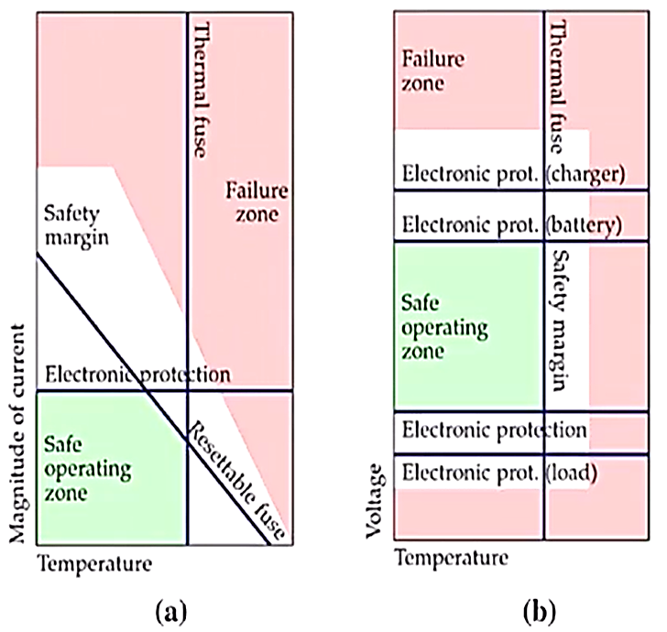

Slide 2
Major features of Battery Management System:
1. Battery Pack Protection Manaqement
A) Electrical Management Protection: Current
B) Electrical Management Protection: Voltage
C) Thermal Management Protection: Temperature
2. Capacitv Manaqement

Slide 3
Electrical Management Protection : Current
Volts
4.0 V
Discharging
Charging
Peak
Continuous
Peak
2.5 V
- 8 A
- 6 A
3 A
15 A
Current

